Slide 1
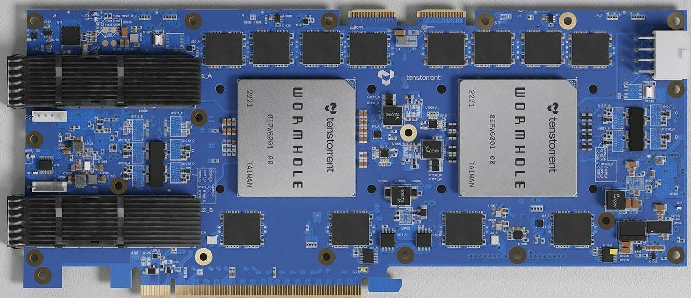


Accessing the Tenstorrent device

Slide 2
Everyone has a visitor account
You have already applied for this via SAFE
You can then use Putty (on Windows) or your inbuilt SSH client (on Linux or MacOS) to SSH into the remote machine

Slide 3
Let’s access the machine
Step one – using the visitor account assigned to you, login to our CS-2 host machine, using the one time pass code
ssh -J user-id@gateway.epcc.ed.ac.uk riscv-login.epcc.ed.ac.uk
We are now logged into the login node
Step two – SSH to tenstorrent machine, load the required SDK module and Git clone the repository and cd into this
[user-id@riscv-login ~]$ ssh tenstorrent1
[user-id@ tenstorrent1 ~]$ module load tt-metal/0.56
[user-id@ tenstorrent1 ~]$ git clone https://github.com/RISCVtestbed/tt-tutorial.git
[user-id@ tenstorrent1 ~]$ cd tt-tutorial/practical
Let one of the tutors know if you are struggling with this

